Slide 1


Travelling Salesman
Problem
Duarte Gonçalves – up202108772
Marco Vilas Boas – up202108774
Pedro Landolt – up202103337

Slide 2

Problem:
The Traveling Salesman Problem (TSP) is an optimization problem that involves finding the shortest possible route for a salesman to visit a given list of cities, while visiting each city exactly once and returning to the starting city. It is a challenging problem with exponential time complexity. No efficient algorithm exists to solve it for all instances. Various algorithms and heuristics have been developed to approximate solutions, making it applicable in logistics, transportation planning, and other fields. TSP remains an active area of research in combinatorial optimization.
Solutions:
Backtracking
Triangular Approximation
Nearest Neighbor
Christofides
Travelling Salesman
Problem
Duarte Gonçalves – up202108772
Marco Vilas Boas – up202108774
Pedro Landolt – up202103337

Slide 3
Problem:
The Traveling Salesman Problem (TSP) is an optimization problem that involves finding the shortest possible route for a salesman to visit a given list of cities, while visiting each city exactly once and returning to the starting city. It is a challenging problem with exponential time complexity. No efficient algorithm exists to solve it for all instances. Various algorithms and heuristics have been developed to approximate solutions, making it applicable in logistics, transportation planning, and other fields. TSP remains an active area of research in combinatorial optimization.
Solutions:
Backtracking
Triangular Approximation
Nearest Neighbor
Christofides

Slide 4
Problem:
The Traveling Salesman Problem (TSP) is an optimization problem that involves finding the shortest possible route for a salesman to visit a given list of cities, while visiting each city exactly once and returning to the starting city. It is a challenging problem with exponential time complexity. No efficient algorithm exists to solve it for all instances. Various algorithms and heuristics have been developed to approximate solutions, making it applicable in logistics, transportation planning, and other fields. TSP remains an active area of research in combinatorial optimization.
Solutions:
Backtracking
Triangular Approximation
Nearest Neighbor
Christofides
Backtracking
Backtrackingis a methodical approach for solving complex problems by incrementally building potential solutions and discarding them if they fail to satisfy certain conditions.
Why use Backtracking for TSP?
TSP is known to be a combinatorial optimization problem with an exponential number of possible solutions.
Backtracking allows us to systematically explore these solutions by making choices and backtracking when necessary.
It helps us find an optimal solution or identify the best possible route within a reasonable amount of time.

Slide 5
Solutions:
Backtracking
Triangular Approximation
Nearest Neighbor
Christofides
Backtracking
Code Review
double Graph::tsp_exact(int pos, ull mask, double **memo){
if (memo[pos][mask] != -1) return memo[pos][mask];
double ans = INF, tmp;
if (mask == (1 << V) - 1) {
return dist[pos][0] > 0 ? dist[pos][0] : INF;
}
for (int i = 0; i < V; i++) {
if (dist[pos][i] == 0) continue; // no edge or self
if (!(mask & (1 << i))) {
tmp = dist[pos][i] + tsp_exact(i, mask | (1 << i), memo);
ans = min(ans, tmp);
}
}
return memo[pos][mask] = ans;
}

Slide 6
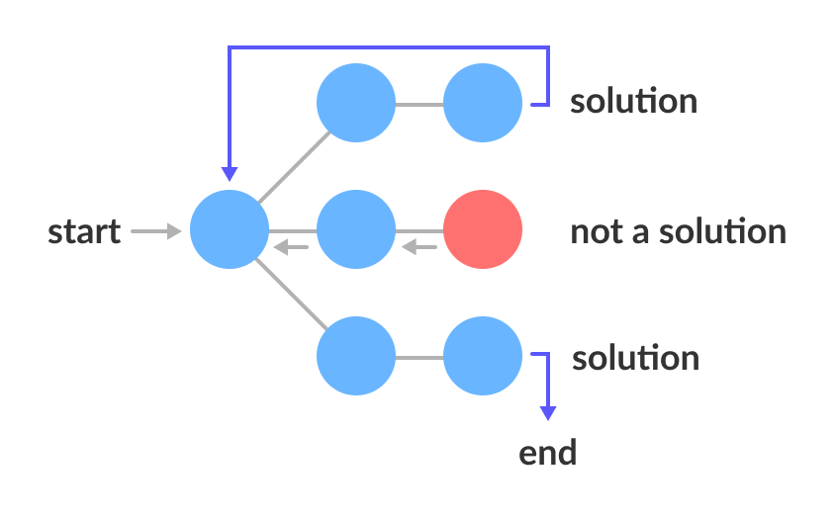
Solutions:
Backtracking
Triangular Approximation
Nearest Neighbor
Christofides
Backtracking
solution
Complexity Analysis
start
not a solution
The Backtracking Algorithm explores all possible permutations of cities, resulting in a time complexity of O($2^{n}∗n^{2}$), where N is the number of cities. For larger instances of TSP, this exponential time complexity becomes computationally infeasible due to the exponential growth of possible solutions.
The Backtracking Algorithm explores all possible permutations of cities, resulting in a time complexity of O(2^𝑛∗𝑛^2), where N is the number of cities. For larger instances of TSP, this exponential time complexity becomes computationally infeasible due to the exponential growth of possible solutions.
The space complexity of the Backtracking Algorithm depends on the depth of the recursion stack O(n) and the size of the matrix of memoization used to keep track of the best solution at a given problem state (city being visited, cities already visited) which is n*$2^{n}$, therefore the space complexity is O(n*$2^{n}$).
The space complexity of the Backtracking Algorithm depends on the depth of the recursion stack O(n) and the size of the matrix of memoization used to keep track of the best solution at a given problem state (city being visited, cities already visited) which is n*2^𝑛, therefore the space complexity is O(n*2^𝑛).
The exponential time complexity makes the Backtracking Algorithm impractical for graphs as big as 25 nodes. Although it guarantees an optimal solution, it becomes increasingly inefficient as the number of cities increases.
solution
end
Time Complexity
Space Complexity
Limitations

Slide 7
Solutions:
Backtracking
Triangular Approximation
Nearest Neighbor
Christofides
Triangular Approximation
The Triangular Approximation Heuristic is a popular algorithm used to solve the Traveling Salesperson Problem (TSP). It provides a practical and efficient approach to finding approximate solutions for TSP instances. Why use Triangular Approximation Heuristic for TSP? The Triangular Approximation Heuristic offers several benefits for solving TSP:
It strikes a balance between solution quality and computational efficiency.
It guarantees a solution within a certain approximation factor of the optimal solution, making it suitable for large-scale problem instances.
It utilizes the triangular inequality property to guide the search for an efficient route.

Slide 8
Solutions:
Backtracking
Triangular Approximation
Nearest Neighbor
Christofides
Triangular Approximation
The Triangular Inequality Property:
The Triangular Approximation Heuristic leverages the triangular inequality property, which states that the direct distance between two cities is always shorter than or equal to the sum of the direct distances via a third city.
This property allows the heuristic to estimate distances and make informed decisions during the optimization process.

Slide 9
Solutions:
Backtracking
Triangular Approximation
Nearest Neighbor
Christofides
Triangular Approximation
Code Review
double Rgraph::tsp_triangular(){
vi path(V);
build_mst(0);
for (auto node: nodes) { node->visited = false; }
int count = 0;
pre_order(0, path, count);
double ans = 0;
for (int i = 0; i < V - 1; i++) {
ans += dist(path[i], path[i + 1]);
}
ans += dist(path[path.back()], path[0]);
return ans;
}

Slide 10

Solutions:
Backtracking
Triangular Approximation
Nearest Neighbor
Christofides
Triangular Approximation
Complexity Analysis
Building of the MST using Prim's Algorithm takes O(E logV) time The pre-order traversal requires visiting all the nodes in the MST. However, since we have the topological data from the nodes, the order in which we visit the children is relevant, so we first need to sort the MST edges that connect to each node in the tree. Therefore, the worst-case time complexity is O(V logV), because the MST has V-1 edges. After this, a simple O(V) loop is enough to calculate the cost of the path, so the time complexity of this approach is dominated by Prim's algorithm since we are (or should be) dealing with complete graphs, E >> V.
The space complexity of Prim's algorithm is O(V), since we need a heap of V size to fit in all the nodes of the graph. After that, we need O(n) space for the recursion stack to pre order traverse the tree. Therefore, the space complexity of this approach is an amazing O(V).
The Triangular Approximation Heuristic provides a good balance between simplicity and efficiency. Although the time complexity is O(E logV), the algorithm's simplicity allows it to handle relatively large problem instances. The space complexity is very good, with just O(V) for the priority queue used in Prim’s algorithm.
Trade-off: The Triangular Approximation Heuristic sacrifices optimality for efficiency by providing an approximate solution. It guarantees a tour that is at most twice the length of the optimal tour. However, the algorithm's simplicity and reasonable time and space complexities make it a popular choice for large-scale TSP instances.
Time Complexity
Space Complexity
Analysis

Slide 11
Solutions:
Backtracking
Triangular Approximation
Nearest Neighbor
Christofides
Nearest Neighbor
The Nearest Neighbor Heuristic is a simple and efficient algorithm for solving the Traveling Salesman Problem (TSP). It belongs to the class of constructive heuristics that build a solution step by step. The algorithm starts at a random city and repeatedly selects the nearest unvisited city until all cities are visited, forming a tour. Why Use Nearest Neighbor Heuristic for TSP?
Quick Initial Solution: The Nearest Neighbor Heuristic provides a fast initial solution, making it suitable for large TSP instances.
Simplicity: The algorithm is easy to implement and understand, requiring minimal computational resources.
Good Approximation: While the Nearest Neighbor Heuristic does not guarantee an optimal solution, it often produces tours that are close to the optimal solution in practice.

Slide 12
Solutions:
Backtracking
Triangular Approximation
Nearest Neighbor
Christofides
Nearest Neighbor
Code Review
double Rgraph::tsp_nearest(){
for (int i = 0; i < V; i++) { nodes[i]->visited = false; }
vi path(V);
path[0] = 0;
nodes[0]->visited = true;
for (int i = 1; i < V; i++) {
int min_pos = nearest_neighbor(path[i - 1]);
path[i] = min_pos;
nodes[min_pos]->visited = true;
}
double ans = 0;
for (int i = 0; i < V - 1; i++) ans += dist(path[i], path[i + 1]);
ans += dist(path[path.back()], path[0]);
return ans;
}

Slide 13
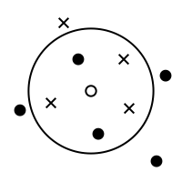
Solutions:
Backtracking
Triangular Approximation
Nearest Neighbor
Christofides
Nearest Neighbor
Complexity Analysis
The time complexity of the Nearest Neighbor Heuristic is O($V^{2}$), where V is the number of cities in the TSP instance. In each iteration, the algorithm compares the distance between the current city and all unvisited cities, resulting in n comparisons. As the algorithm visits each city exactly once, the total number of comparisons is approximately $V^{2}$.
The time complexity of the Nearest Neighbor Heuristic is O(𝑉^2), where V is the number of cities in the TSP instance. In each iteration, the algorithm compares the distance between the current city and all unvisited cities, resulting in n comparisons. As the algorithm visits each city exactly once, the total number of comparisons is approximately 𝑉^2.
The space complexity of the Nearest Neighbor Heuristic is O(V+E), where V is the number of cities in the TSP instance and E is the number of connections between the cities.
The Nearest Neighbor Heuristic offers a relatively low time complexity, making it efficient for solving TSP instances with a large number of cities. However, it should be noted that the heuristic does not guarantee an optimal solution and may produce suboptimal tours. Despite its simplicity, the Nearest Neighbor Heuristic provides a good trade-off between computational efficiency and solution quality.
Time Complexity
Space Complexity
Analysis

Slide 14
Solutions:
Backtracking
Triangular Approximation
Nearest Neighbor
Christofides
Christofides
Christofides Algorithm is an approximate algorithm used to solve the Traveling Salesman Problem (TSP). It was developed by Nicos Christofides in 1976 and provides a solution that is guaranteed to be within a factor of 3/2 times the optimal solution. Why use Christofides Algorithm for TSP?
TSP is an NP-hard problem, meaning that finding an optimal solution for large instances is computationally infeasible.
Christofides Algorithm offers a good approximation for TSP with a theoretical guarantee on solution quality.
It provides a balance between computational efficiency and solution quality, making it suitable for practical applications.

Slide 15
Solutions:
Backtracking
Triangular Approximation
Nearest Neighbor
Christofides
Christofides
Key Features of Christofides Algorithm:
Utilizes a combination of minimum spanning tree (MST) and perfect matching techniques.
Constructs an MST of the given TSP graph using Prim's algorithm.
Identifies vertices with odd degree in the MST and finds a minimum-weight perfect matching among them.
Combines the MST and the matching to form a multigraph with even degree vertices.
Finally, it finds an Eulerian circuit in the subgraph, which may visit each vertex more than once, forming a tour that is not yet valid, however, by just removing the duplicates, we get the answer.

Slide 16
Solutions:
Backtracking
Triangular Approximation
Nearest Neighbor
Christofides
Christofides
Code Review
double Rgraph::tsp_christofides(){
vi degree(V, 0), matching(V, -1), path;
build_mst(0);
for (auto v: nodes) {
degree[v->id] = (int) mst_edges[v->id].size();
if (degree[v->id] % 2) { v->visited = false; }
else { v->visited = true; }
}
min_weight_matching(matching); // find min weight matching
overlap(matching); // add edges from matching to MST
euler_tour(path); // find euler tour
…
…
vi visited(V, 0);
visited[path[0]] = 1;
double ans = 0;
n = (int) path.size();
for (int i = 0; i < n - 1; i++) {
if (!visited[path[i + 1]]) {
ans += dist(path[i], path[i + 1]);
visited[path[i + 1]] = 1;
}
}
ans += dist(path.back(), path[0]);
return ans;
}

Slide 17
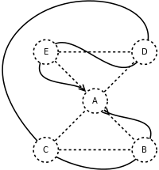
Solutions:
Backtracking
Triangular Approximation
Nearest Neighbor
Christofides
Christofides
Code Review
The time complexity of the Christofides Algorithm for solving the TSP depends on the size of the input graph, typically represented by the number of cities. The algorithm involves several steps such as finding a minimum spanning tree, finding a minimum weight perfect matching, and constructing the final Hamiltonian cycle. The overall time complexity of the Christofides Algorithm is O($n^{3}$), where n is the number of cities. This time complexity comes from finding the minimum weight perfect matching using the Blossom algorithm. In this project, to not ‘overcomplicate’, we used a greedy approach to this step, which has a better time complexity of O($n^{2}$) and yields a matching that is still perfect but not minimum weight (this makes the algorithm not guarantee the 3/2 bound).
The time complexity of the Christofides Algorithm for solving the TSP depends on the size of the input graph, typically represented by the number of cities. The algorithm involves several steps such as finding a minimum spanning tree, finding a minimum weight perfect matching, and constructing the final Hamiltonian cycle. The overall time complexity of the Christofides Algorithm is O(𝑛^3), where n is the number of cities. This time complexity comes from finding the minimum weight perfect matching using the Blossom algorithm. In this project, to not ‘overcomplicate’, we used a greedy approach to this step, which has a better time complexity of O(𝑛^2) and yields a matching that is still perfect but not minimum weight (this makes the algorithm not guarantee the 3/2 bound).
The space complexity of the Christofides Algorithm is primarily determined by the data structures used to represent the input graph and intermediate results. The algorithm requires storing the adjacency matrix or adjacency list to represent the graph, as well as additional data structures for intermediate computations. The space complexity of the Christofides Algorithm is therefore O(V + E). Although the space requirements grow with the number of cities, it is generally manageable for practical problem instances.
The Christofides Algorithm provides an approximation solution for the TSP with a performance guarantee of at most 1.5 times the optimal solution. By incorporating the minimum weight perfect matching in the algorithm, it helps to reduce the total distance traveled compared to simpler heuristics like the Triangle Approximation. However, the algorithm's time complexity of O($n^{3}$) makes it less efficient for larger problem instances, where faster heuristic approaches like the Triangle Approximation may be preferred. Despite the higher time complexity, the Christofides Algorithm is valuable when an approximate solution within a certain factor of the optimal solution is needed, and a better approximation is desired than simpler heuristics.
The Christofides Algorithm provides an approximation solution for the TSP with a performance guarantee of at most 1.5 times the optimal solution. By incorporating the minimum weight perfect matching in the algorithm, it helps to reduce the total distance traveled compared to simpler heuristics like the Triangle Approximation. However, the algorithm's time complexity of O(𝑛^3) makes it less efficient for larger problem instances, where faster heuristic approaches like the Triangle Approximation may be preferred. Despite the higher time complexity, the Christofides Algorithm is valuable when an approximate solution within a certain factor of the optimal solution is needed, and a better approximation is desired than simpler heuristics.
Time Complexity
Space Complexity
Analysis

Slide 18
Statistics
Triangular Approximation
Christofides
vs
Distance Comparison
Time Comparison

Slide 19
Statistics
Distance Comparison
Time Comparison

Slide 20
Demonstration

